Slide 1
HERCULES 2021 - TUTORIAL Modelling SR beamlines using OASYS
Manuel Sánchez del Río
AAMP, MEG, ISDD, ESRF
2021 March 3rd 14:00

Slide 2
Outline
Introduction to OASYS
XOPPY toolbox: Source emission and characteristics of optical elements. Power transport
ShadowOUI: Ray tracing SR beamlines
Mirror aberrations
Crystal systems
Lenses
WOFRY and SRW: coherent beam transport:
Simple examples with WOFRY
Introduction to Partial coherence

Slide 3
Outcome Calculate main characteristics of synchrotron sources (dipoles and IDs) Simulating beamline optics by ray-tracing to obtain main parameters of beam size, energy resolution and flux Understand basic principles of x-ray optics: Reflective (aberrations, slope errors), Diffractive (dispersion) and Refractive (chromatic aberrations) A few concepts (only) about coherence

Slide 4
Outline
Introduction to OASYS
XOPPY toolbox: Source emission and characteristics of optical elements. Power transport
ShadowOUI: Ray tracing SR beamlines
Mirror aberrations
Crystal systems
Lenses
WOFRY and SRW: coherent beam transport:
Simple examples with WOFRY
Introduction to Partial coherence

Slide 5

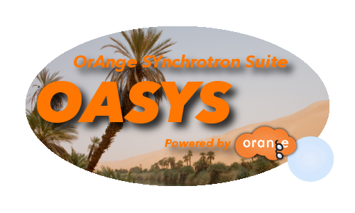
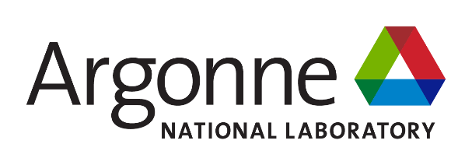
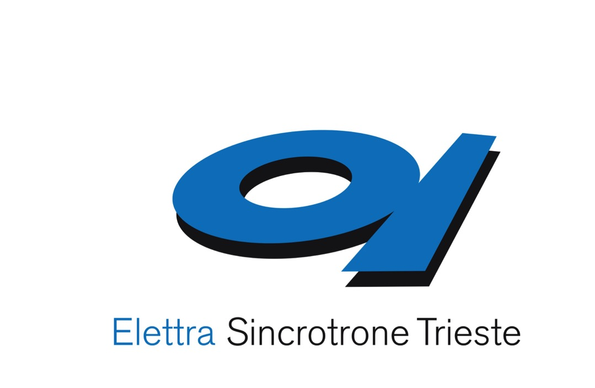

The OASYS Project
https://oasys-kit.github.io/
Luca Rebuffi
Manuel Sanchez del Rio
OASYS = OrAnge SYnchrotron Suite
A common platform to build synchrotron-oriented User Interfaces that communicate
The upper layer of the application presented to the user
Open Source & Python technology
Luca Rebuffi, Manuel Sanchez del Rio (2017)
OASYS (OrAnge SYnchrotron Suite) : an open-source graphical environment for x-ray virtual experiments
Proc.SPIE 10388: 10388-10388. http://dx.doi.org/10.1117/12.2274263
Notes:
Slide 3 – (..) : Content of the presentation
Insert a new slide: Home > “New Slide” and choose a slide Layout:
For Title & Subtitle
For text with bullet points
For Text
For Picture, graphs, visuals
Two columns
Blank
If you want Copy & paste an element from the Clip Board to the particular slide: 1. Click on a box to mark it.
2. Position the mouse pointer on the box frame: Copy! 3. Click on the particular slide: Paste!
How you intend to use the elements is your choice. You can combine the text block style with the background colour in different manner.

Slide 6
Synchrotron Virtual Experiments
Beamline Experiment Chain
Storage Ring
(e⁻ optics)
Radiation devices
(e⁻ -> γ)
Beamline
(γ optics)
Sample
(γ −matter interactions)
Suite of Add-ons
XOPPY
ShadowOui
WOFRY
X-ray server
WISE
COMSYL

Slide 7
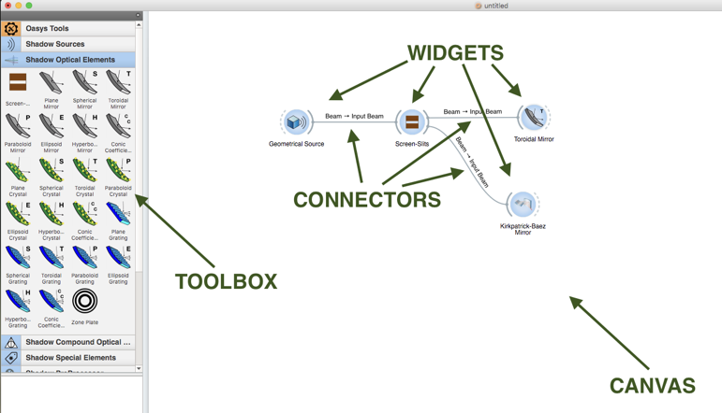
The OASYS language

Slide 8
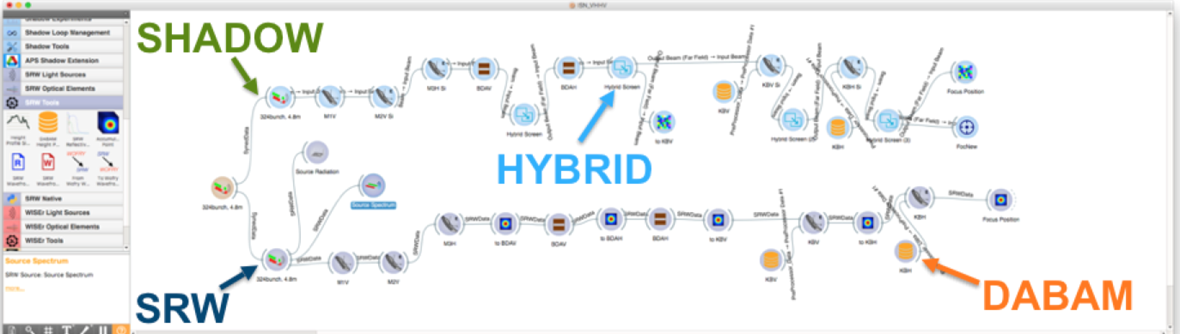
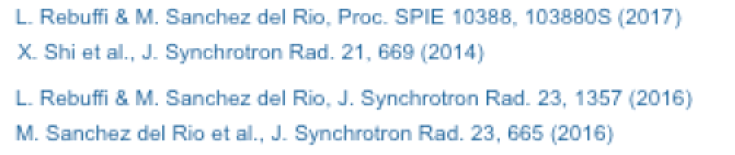
Multiple tools in the same environment

Slide 9
References
Official Web Page
https://www.aps.anl.gov/Science/Scientific-Software/OASYS
M. Sanchez del Rio, L. Rebuffi, J. Demšar, N.Canestrari and O. Chubar, A proposal for an open source graphical environment for simulating X-ray optics, Proc. SPIE 9209, 92090X (2014)​
X. Shi, R. Reininger, M. Sanchez del Rio, L. Assoufid, A hybrid method for X-ray optics simulation: combining geometric ray-tracing and wavefront propagation, J. Synchrotron Rad. 21, 669 (2014)
X. Shi, R. Reininger, M. Sanchez del Rio, J. Qian, L. Assoufid, X-ray optics simulation and beamline design using a hybrid method: diffraction-limited focusing mirrors, Proc. SPIE, 9209, 920909 (2014)
OASYS Publications
M. Sanchez del Rio, D. Bianchi, D. Cocco, M. Glass, M. Idir, J. Metz, L. Raimondi, L. Rebuffi, R. Reininger, X. Shi, F. Siewert, S. Spielmann-Jaeggi, P. Takacs, M. Tomasset, T. Tonnessen, A. Vivo and V. Yashchuk, DABAM: an open-source database of X-ray mirrors metrology, J. Synchrotron Rad. 23 (2016).
L. Rebuffi, M. Sanchez del Rio, ShadowOui: A new visual environment for X-ray optics and synchrotron beamline simulations, J. Synchrotron Rad. 23 (2016)
L. Rebuffi, M. Sanchez del Rio, Interoperability and complementarity of simulation tools for beamline design in the OASYS environment, Proc. SPIE 10388, 1038808 (2017)​.​​​​​​
L. Rebuffi, M. Sanchez del Rio, OASYS (OrAnge SYnchrotron Suite): an open-source graphical environment for x-ray virtual xperiments, Proc. SPIE 10388, 103880S (2017)​​​​​.

Slide 10
Three sessions
XOPPY (tools) hercules_xoppy.ows
ShadowOUI (ray tracing) hercules_shadowoui.ows
WOFRY (wave optics) hercules_wofry.ows

Slide 11
Computer simulation of light sources and optical components is a mandatory step in the design and optimization of synchrotron and FEL radiation beamlines
different codes for numerical simulations are available, implementing different physical approaches
RAY-TRACING
WAVEFRONT
PROPAGATION
Shadow
RAY
SRW
PHASE
COMSYL
XRT
McXtrace
WISE
WOFRY
Notes:
Slide 3 – (..) : Content of the presentation
Insert a new slide: Home > “New Slide” and choose a slide Layout:
For Title & Subtitle
For text with bullet points
For Text
For Picture, graphs, visuals
Two columns
Blank
If you want Copy & paste an element from the Clip Board to the particular slide: 1. Click on a box to mark it.
2. Position the mouse pointer on the box frame: Copy! 3. Click on the particular slide: Paste!
How you intend to use the elements is your choice. You can combine the text block style with the background colour in different manner.

Slide 12
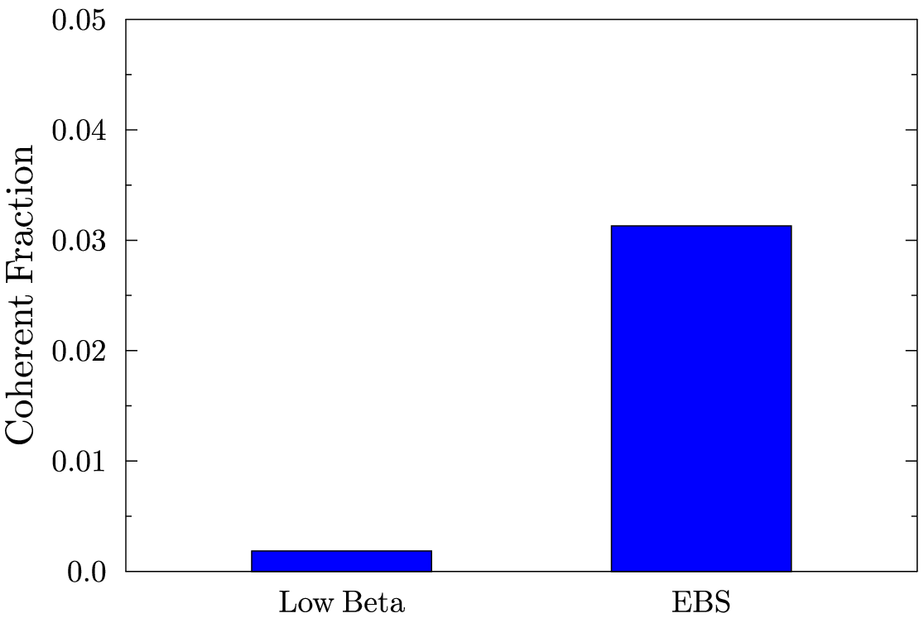
At HIGH ENERGIES, WE ARE FAR FROM DIFFRACTION-LIMIT (=FULLY COHERENCE) U17 2m @ 17 keV (K=0.4842) L=2m Coherent Fraction THEREFORE, ANY BEAMLINE SIMULATION MUST START WITH RAY TRACING (INCOHERENT BEAMS)
3.13 %
0.18 %

Slide 13
Outline
Introduction to OASYS
XOPPY toolbox: Source emission and characteristics of optical elements. Power transport
ShadowOUI: Ray tracing SR beamlines
Mirror aberrations
Crystal systems
Lenses
WOFRY and SRW: coherent beam transport:
Simple examples with WOFRY
Introduction to Partial coherence

Slide 14
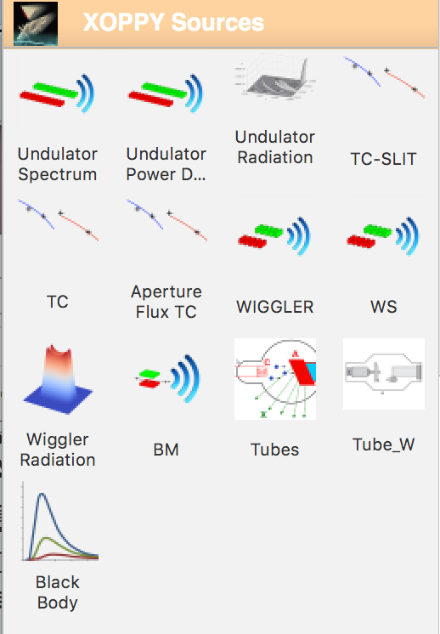
Source emission (XOPPY)
Undulator spectrum (flux or power versus E)
Undulator power density (power versus X,Y)
Undulator Spectrum (flux/power vs X,Y,E)
Undulator tuning curves
Wiggler spectrum Spectrum (flux/power vs X,Y,E)
BM Spectrum (flux/power vs E, angle)
Others

Slide 15
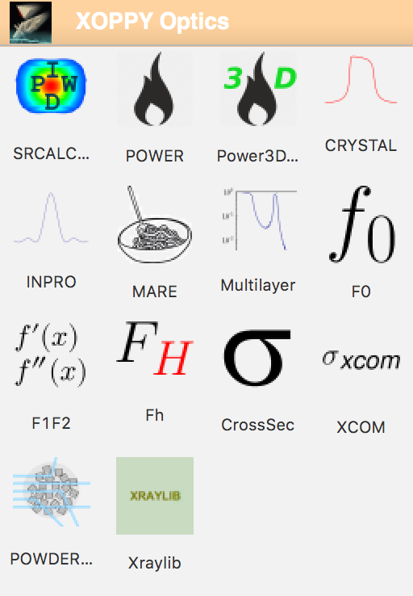
Optical elements (XOPPY)
Attenuators
Mirrors
Multilayers
Crystals

Slide 16
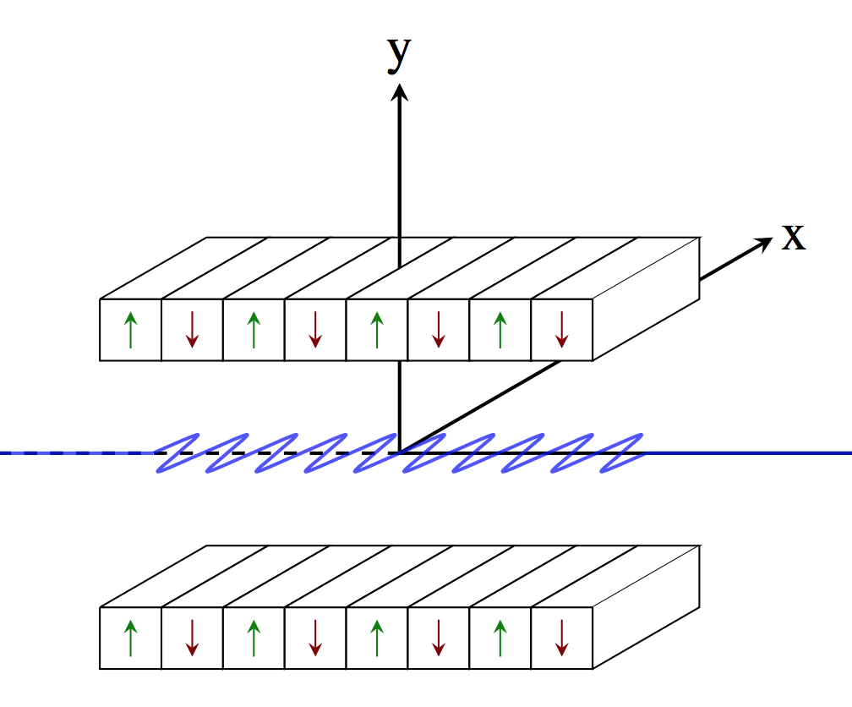
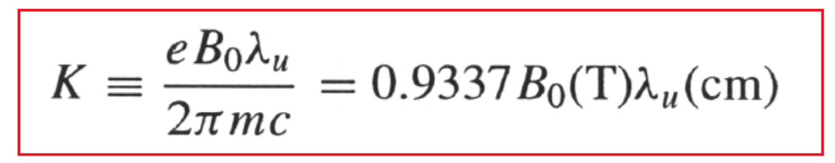
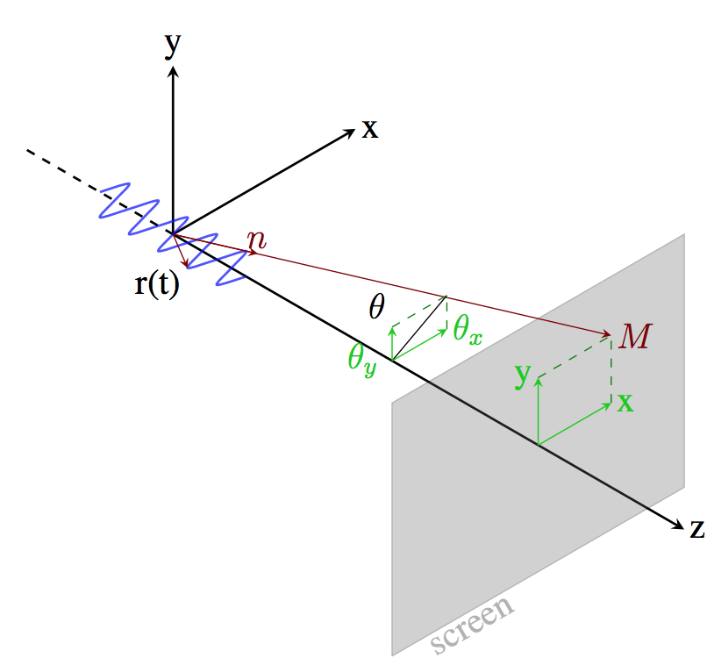
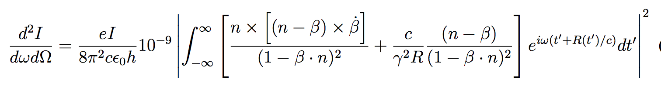
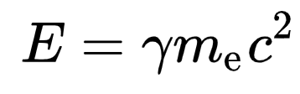
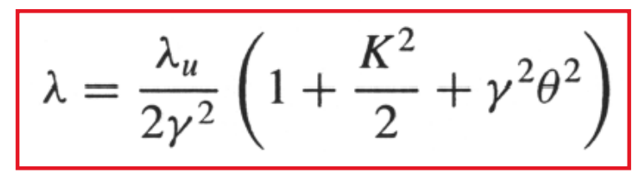
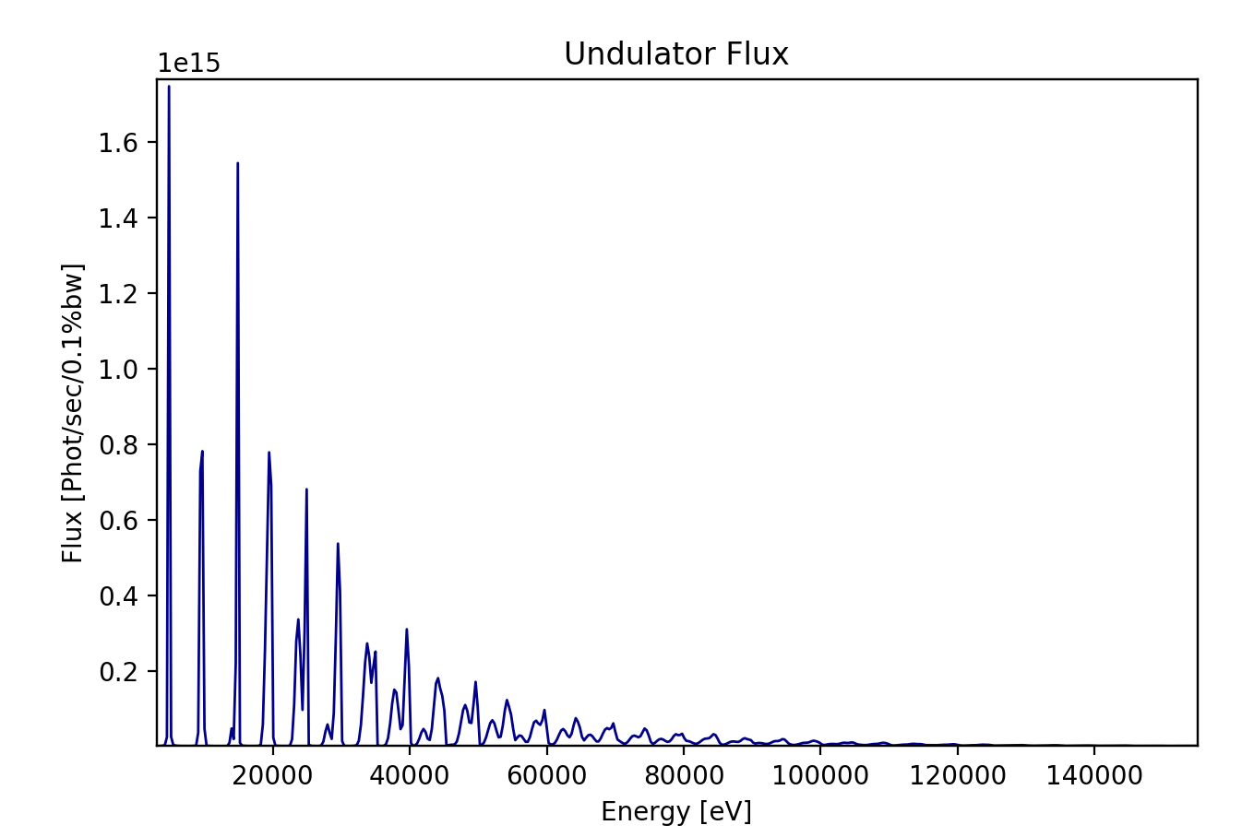
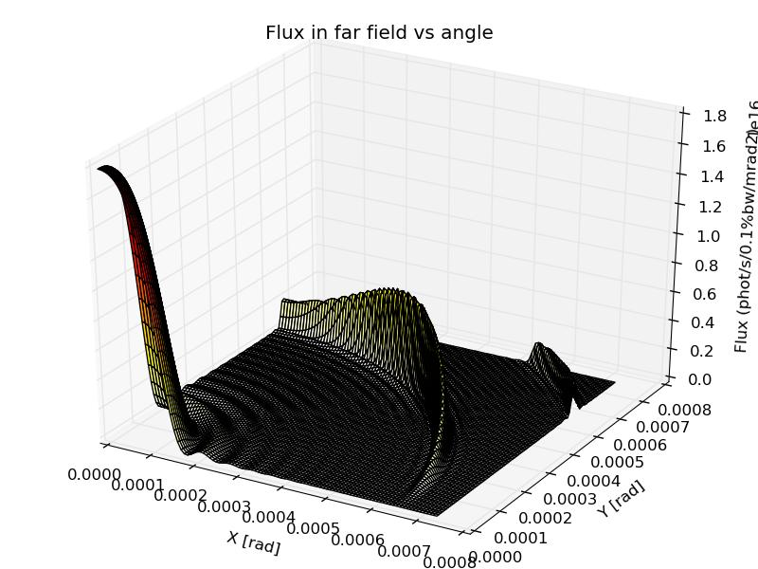
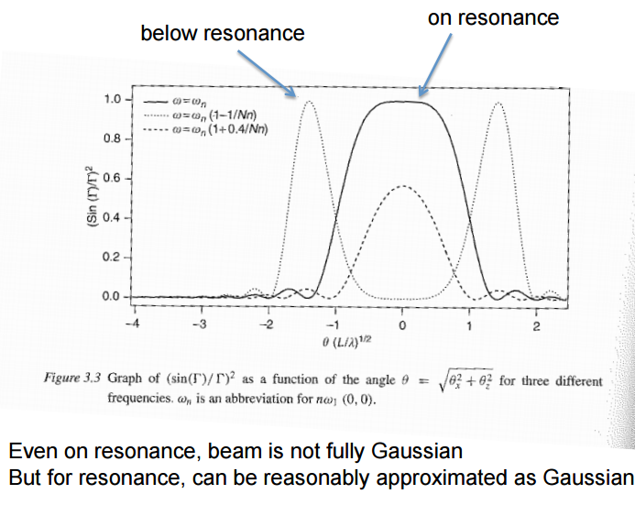
Undulator Memorandum
Undulator emission, after classical electrodynamics (e.g., Jackson, etc)
m_{e}c² = 0.51 MeV
On resonance
Approximation
On resonance
16

Slide 17
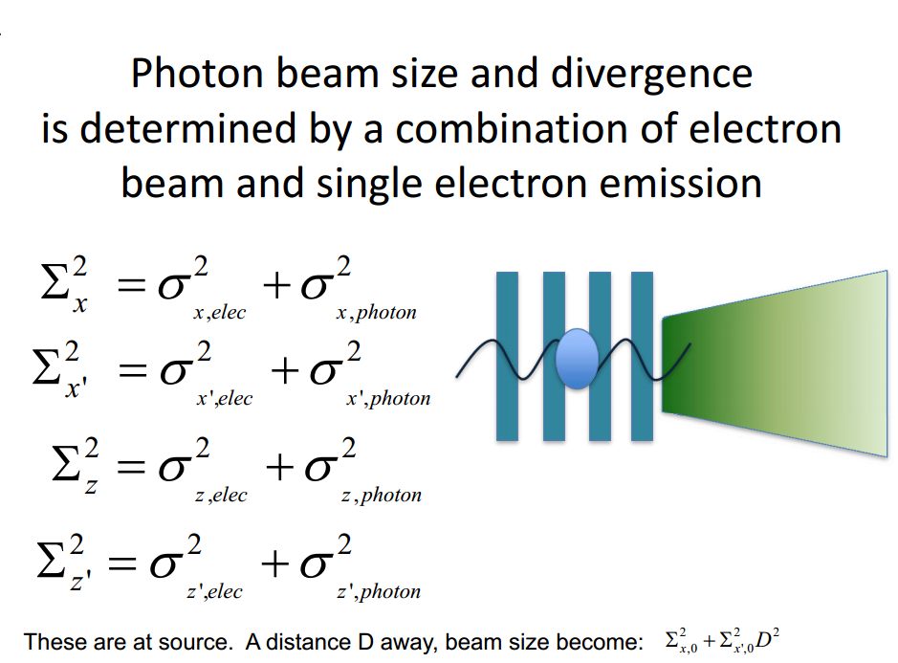
Courtesy: Boaz Nash
(FOR UNDULATORS, THESE FORMULAS ARE VALID AT THE WAIST, AT THE UNDULATOR RESONANCE, AND SUPOSSING GAUSSIAN EMISSION OF PHOTONS)
ShadowOui performs “numeric convolution” by Monte Carlo sampling of the electron beam [Gaussian] and photon emission [non Gaussian]

Slide 18
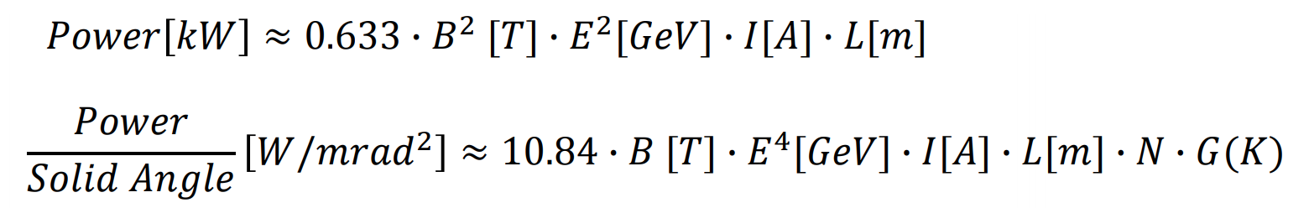
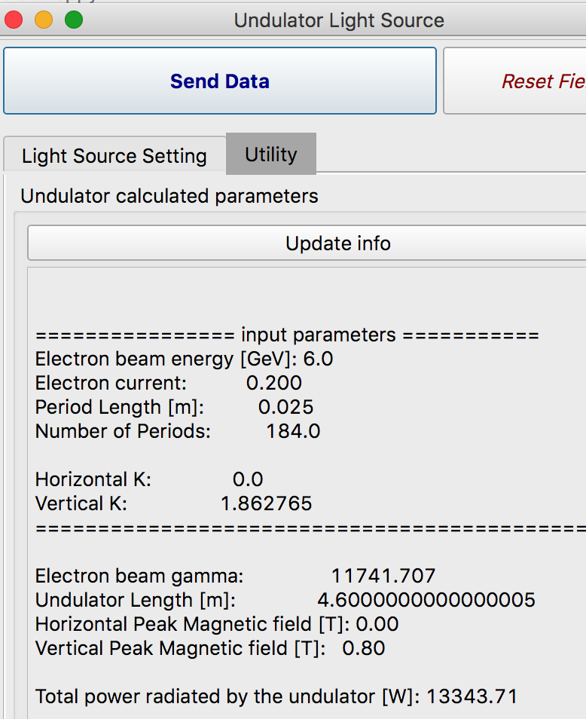
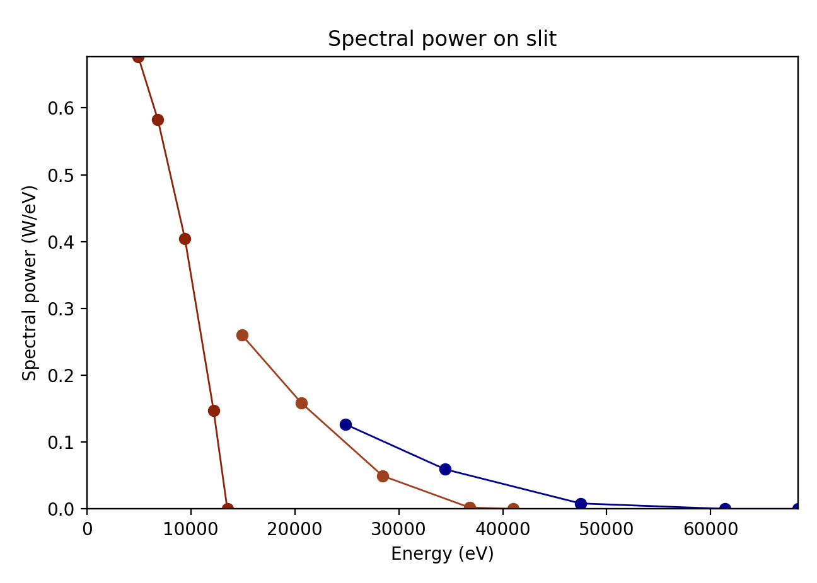
Undulators: Power and spectral calculations
Maximum power is obtained at highest K (or B) corresponding to the minimum photon energy
The spectral range covered by undulator is shown by the Tuning Curves.
Second OASYS School – ANL APS - December 11-13, 2019
18

Slide 19
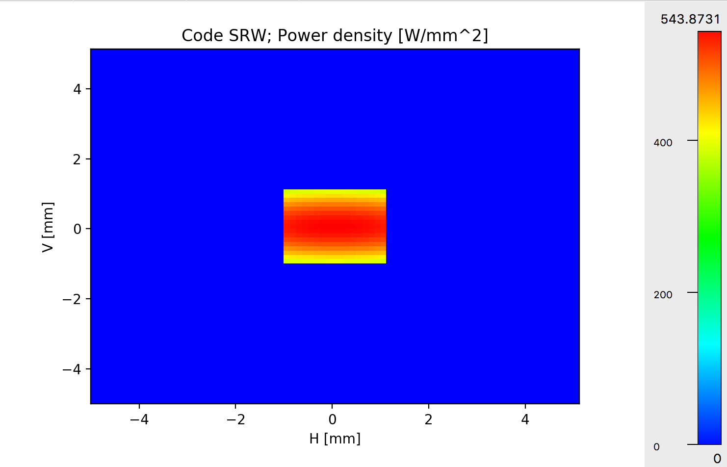
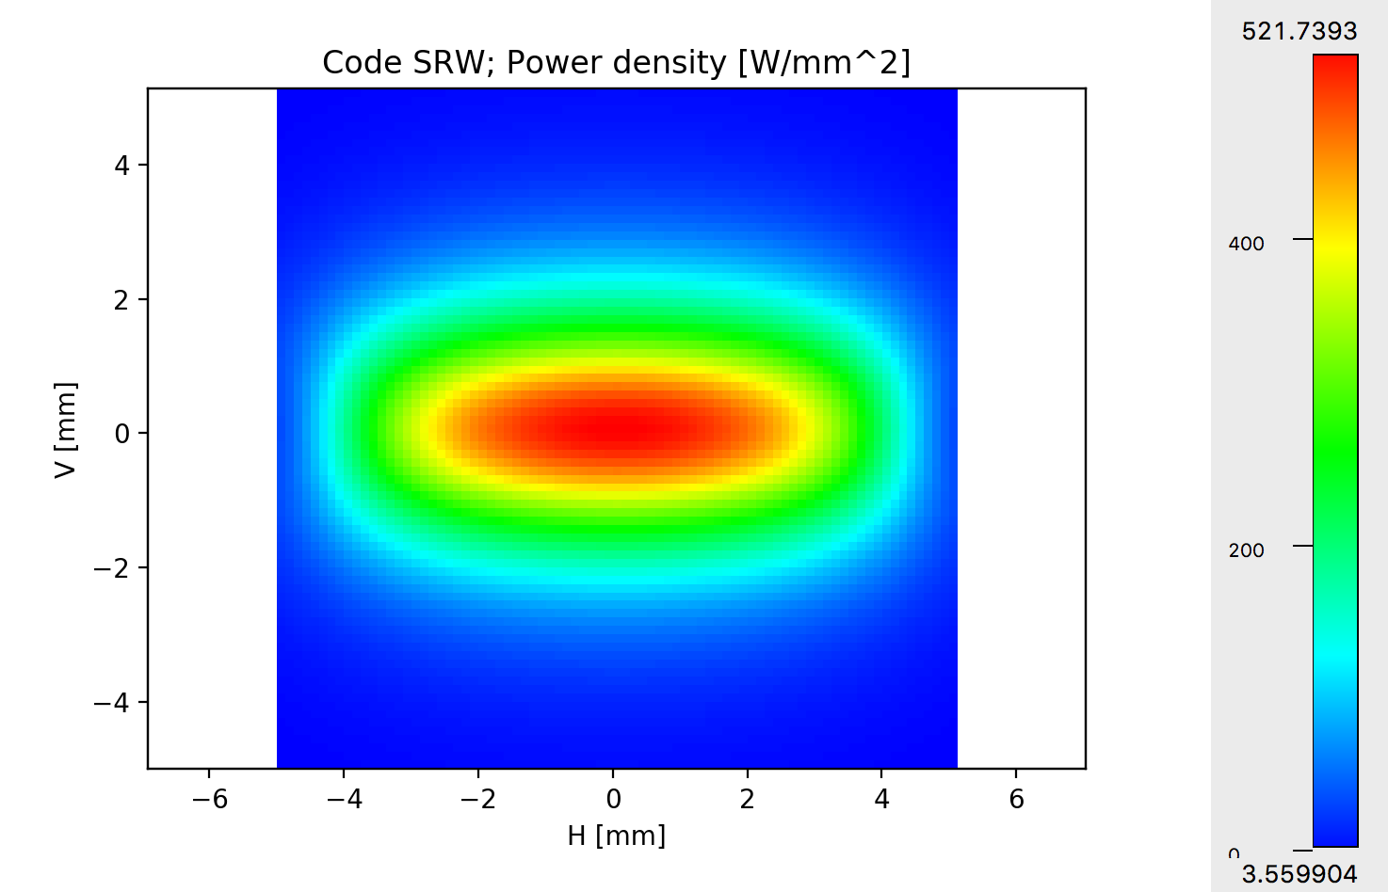
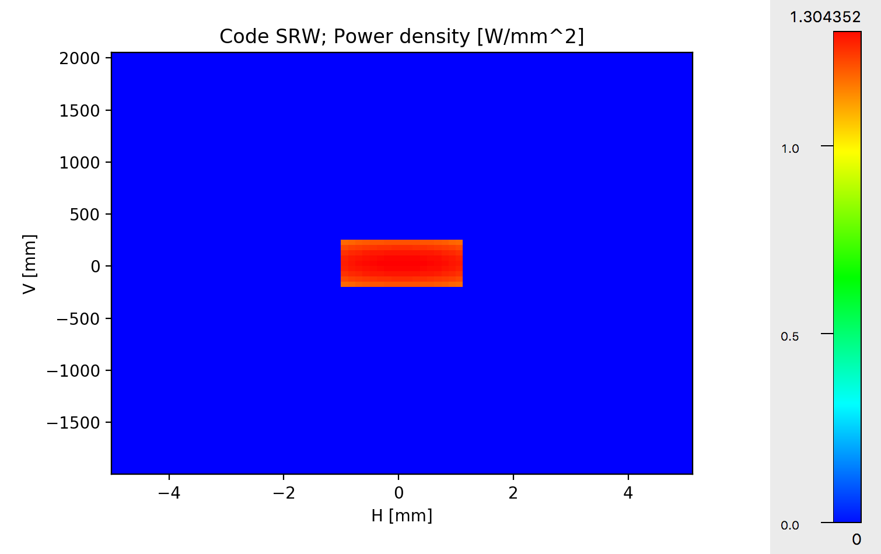
Power density (Power vs X and Y)
Mask
2x2 mm @ 25.4,=m
Or
2.1x2.1 @ 28m
6 sigma 1.32 mm
Mirror:
400mm
2.1mm (mask)
Tips:
Calculate on aperture large enough to accept all the radiation
Select “modify slit” to calculate power on smaller slit and to calculate power density on mirror surface
Second OASYS School – ANL APS - December 11-13, 2019
19

Slide 20
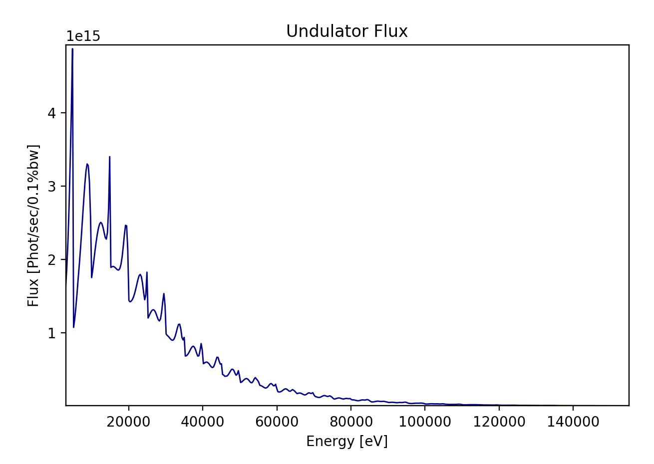
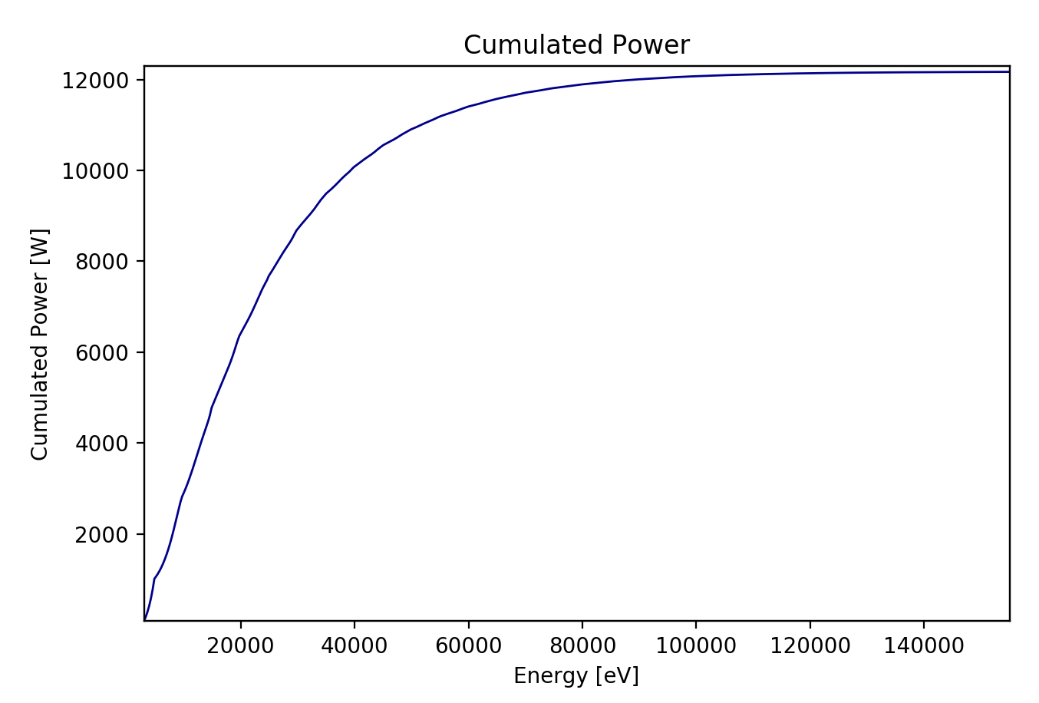
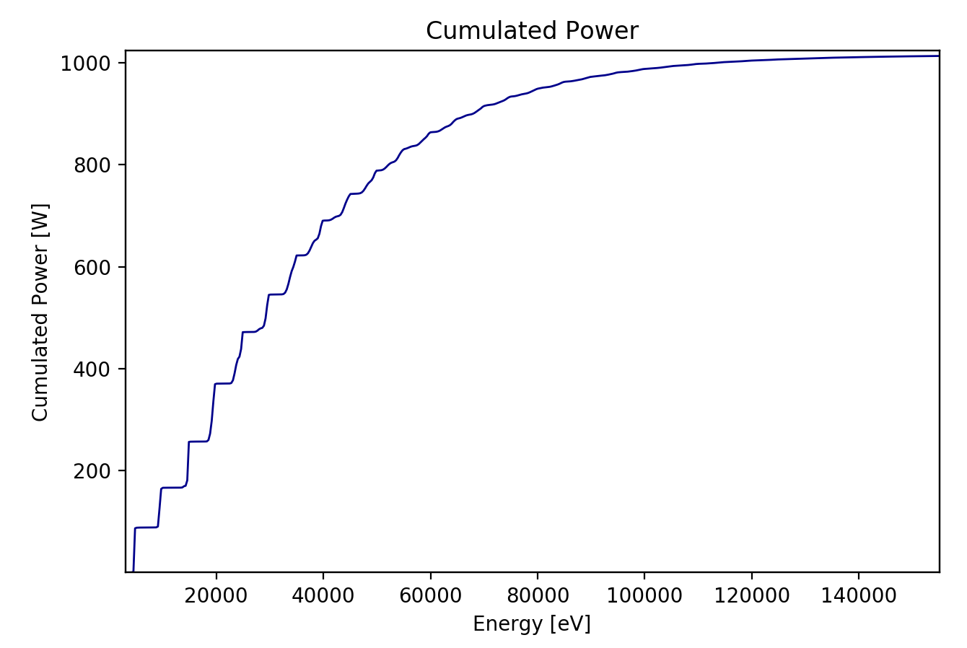
Flux and Spectral Power
Open Slit (10 x 10 mm²)
Slit (2.1 x 1 mm²)
Second OASYS School – ANL APS - December 11-13, 2019
20

Slide 21
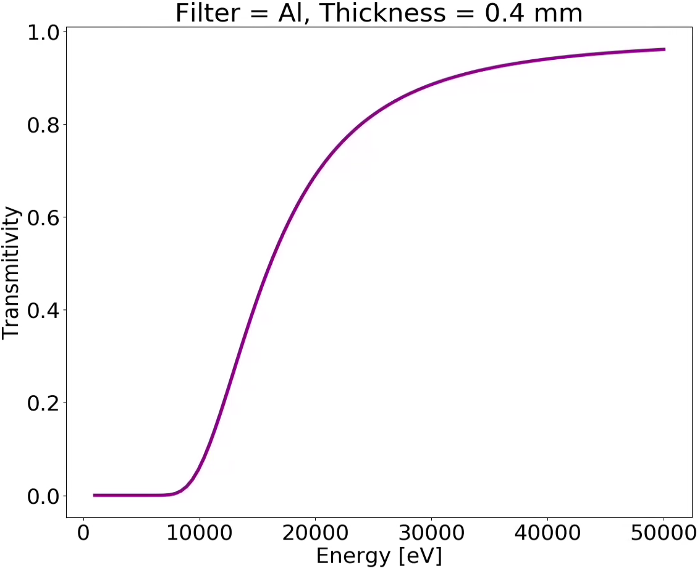

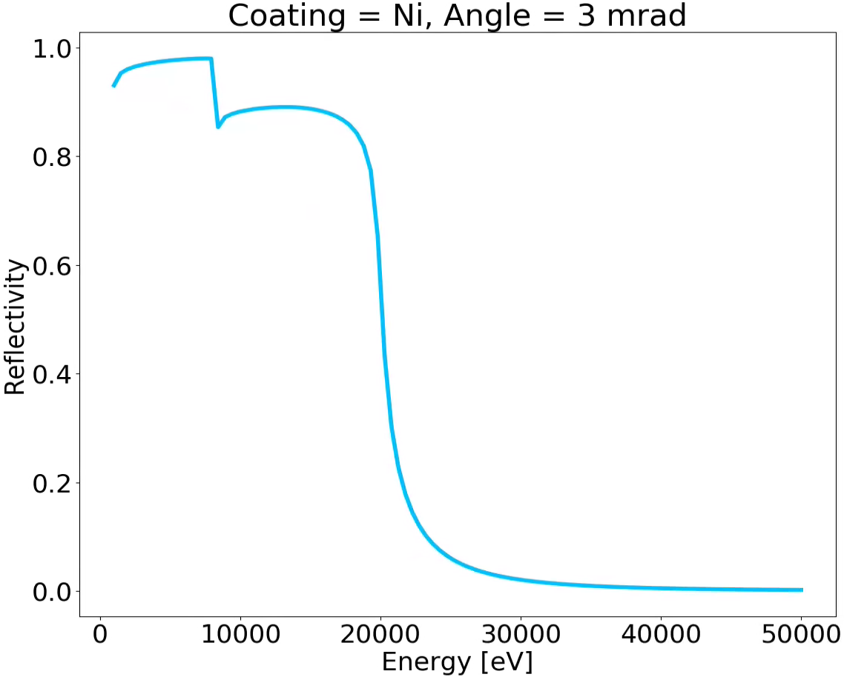
Spectral response of mirrors and attenuators (filters)
XOPPY
Interaction of radiation with matter
0.4 mm
X-ray beam
Al
X-ray beam
Mirror Angle
Ni coating
Second OASYS School – ANL APS - December 11-13, 2019
21

Slide 22
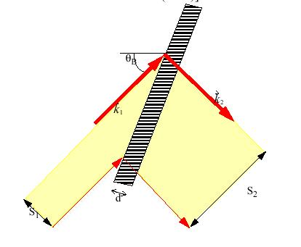
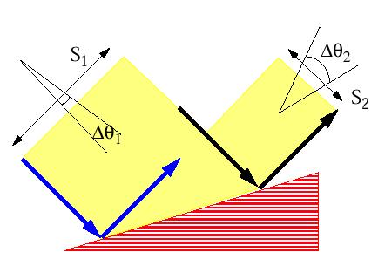
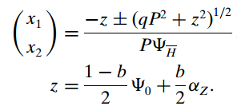
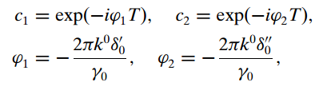
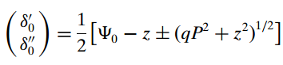
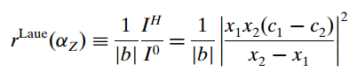
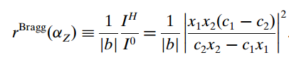
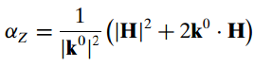
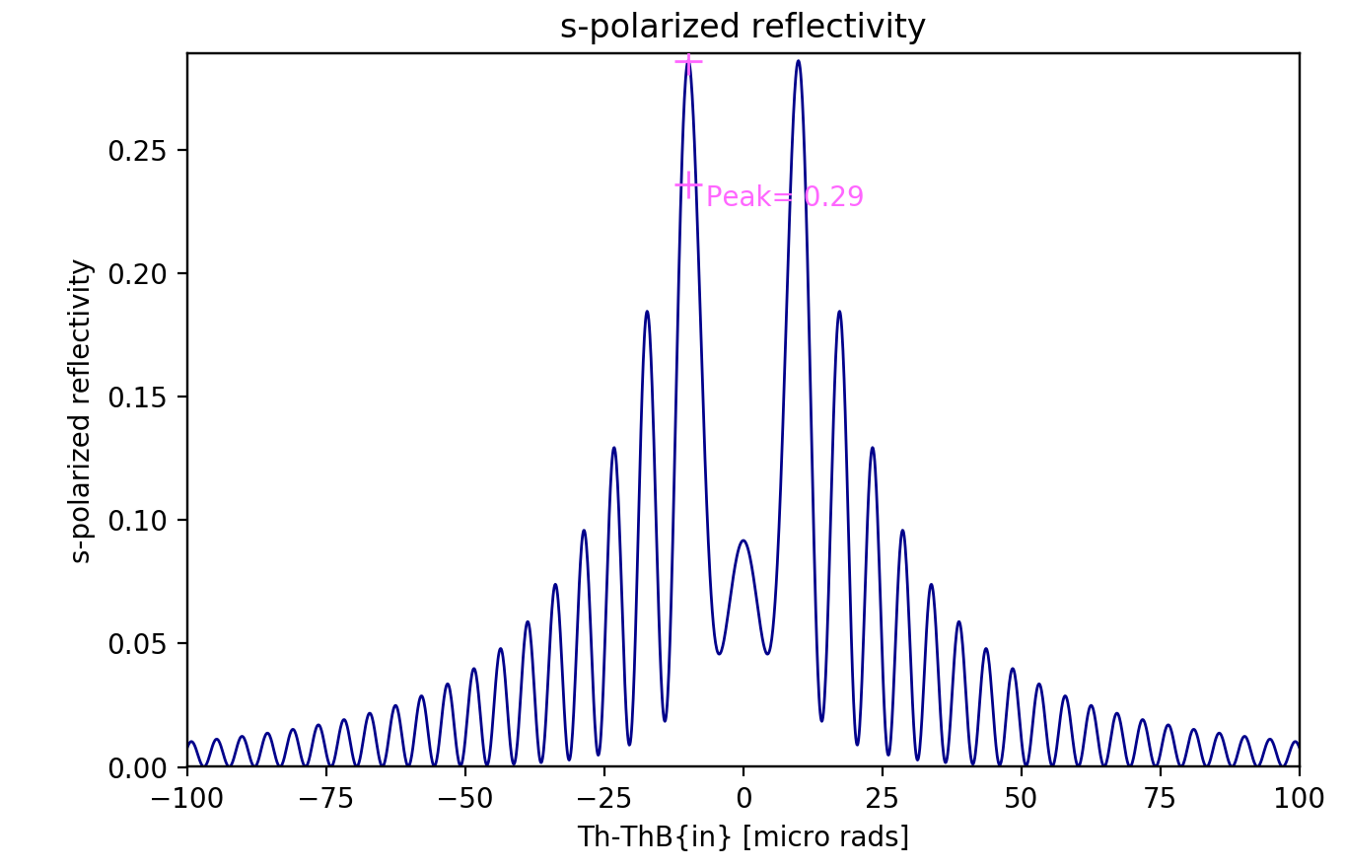
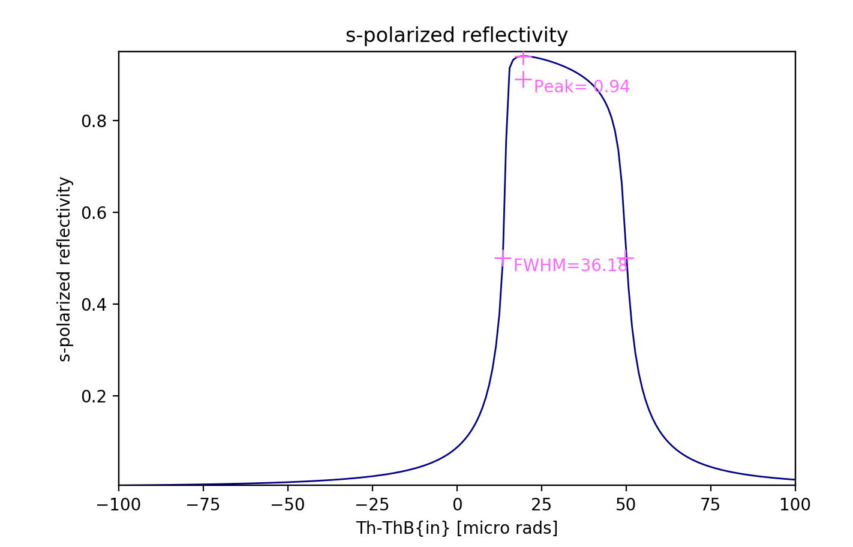
Crystals: Zachariasen treatment for plane crystals
BRAGG or reflection
LAUE or transmission
Second OASYS School – ANL APS - December 11-13, 2019
22

Slide 23
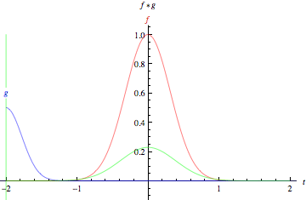
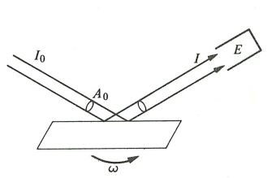
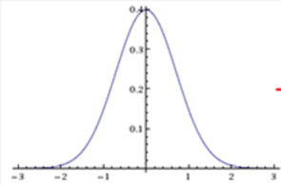
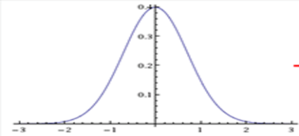

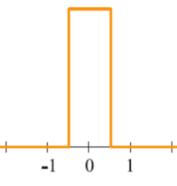
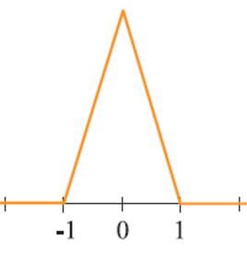
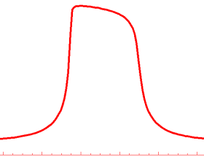
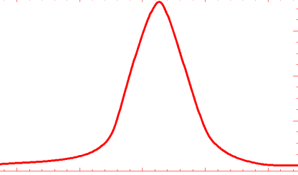
Crystals: Rocking curves
The rocking curve is the CONVOLUTION of the two diffraction profiles.
=
FWHM_{R} = 1.4 FWHM₁
=
FWHM_{R} = 1 FWHM₁
=
FWHM_{R} ~ 1.5 FWHM₁
_{Si111 8 keV}
For a full discussion about rocking curves see: Masiello et al. J. Appl. Crystall. 47, 1304-1314 (2014)
Second OASYS School – ANL APS - December 11-13, 2019
23

Slide 24
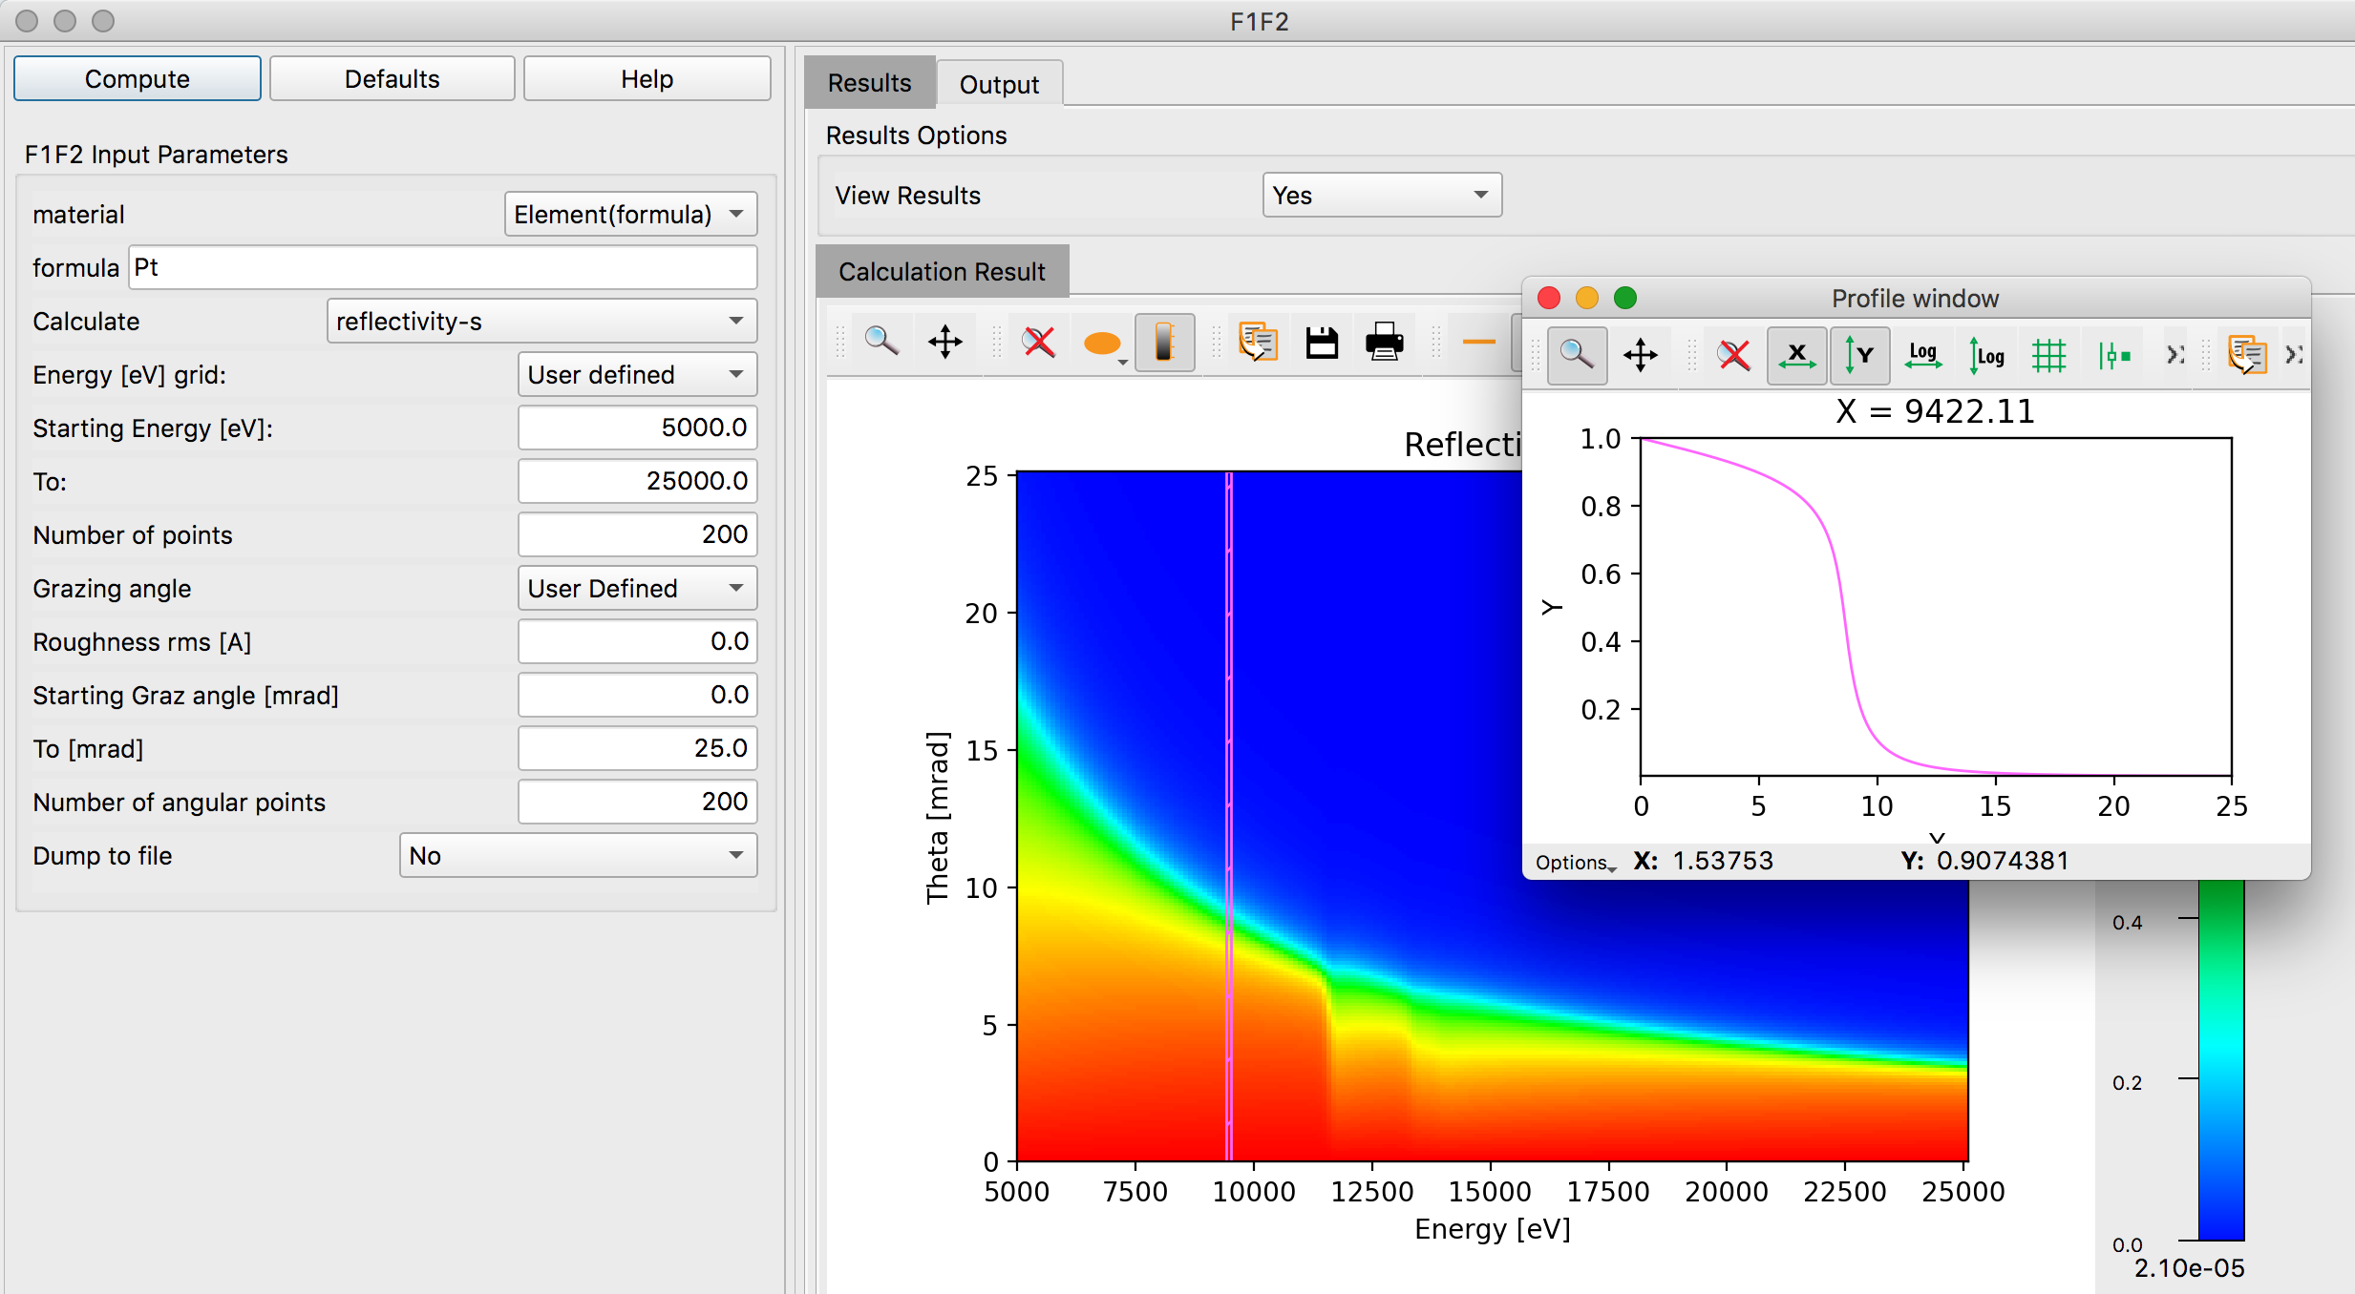
Mirror reflectivity F1F2
Second OASYS School – ANL APS - December 11-13, 2019
24

Slide 25
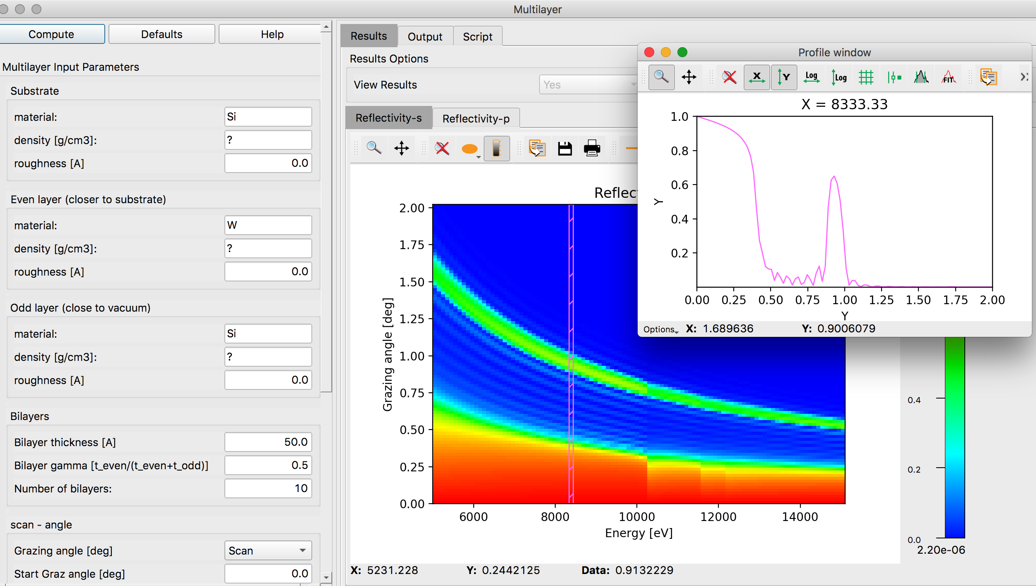
Multilayer reflectivity
Second OASYS School – ANL APS - December 11-13, 2019
25

Slide 26
Hyerarchical approach

Slide 27
Outline
Introduction to OASYS
XOPPY toolbox: Source emission and characteristics of optical elements. Power transport
ShadowOUI: Ray tracing SR beamlines
Mirror aberrations
Crystal systems
Lenses
WOFRY and SRW: coherent beam transport:
Simple examples with WOFRY
Introduction to Partial coherence

Slide 28
Trace (the beamline)
z
Energy, Intensity
y
x
z
z
p
q
x
y
x

Slide 29
Trace (the beamline)
z
Energy, Intensity
y
x
z
y
z
p
q
x
y
x

Slide 30
Optical elements
For each optics element SHADOW includes:
Geometrical model: how the direction of the rays are changed (reflected, refracted or diffracted)
Physical model: how the ray intensity (in fact electric fields) decreases because of the interaction
Structures along the surface =>playing with the direction
Structures in depth => playing with the reflectivity

Slide 31





ShadowOUI Sources I

Slide 32







Sources II (Wiggler and also mutiple BMs and Short IDs)

Slide 33









Sources III (Undulator)
Fake Geometrical Source
(Gaussian spatial + Gaussian divergency)
Single e⁻
Photon source:
Divergence:
Size:
Full Undulator
789.938eV
806.060eV
814.121eV

Slide 34



Optical Elements (mirrors) Geometrical model Physical model
Fresnel equations give the reflectivity as a function of angle and photon energy. As a consequence, one gets the critical angle:
Si σ-reflectivity

Slide 35

Optical Elements (gratings)
Geometrical model Physical model
No model (yet) in SHADOW for grating efficiency
SHADOW uses Fresnel equations like for mirrors
Figure from doi.org/10.5772/51044

Slide 36


Optical Elements (crystals)
Geometrical model Physical model

Slide 37

Mirrors and aberrations
R
Ellipsoid: Point to point focusing
Paraboloid: Collimating
Focalization in two planes
Tangential or Meridional (ellipse or parabola)
Sagittal (circle)
Demagnification: M=p/q
Easier manufacturing:
2D: Ellipsoid => Toroid
Only one plane: cylinder Ellipsoid (ellipse)=> cylinder (circle)
Sagittal radius: non-linear (ellipsoid) => constant (cylinder) or linear (cone),
All mirrors produce aberrations
p
q
ρ

Slide 38





Crystal monochromators
ex17_crystalmono.ows
Theory of the Use of More Than Two Successive X-Ray Crystal Reflections to Obtain Increased Resolving Power J W. M. DuMond Phys. Rev. 52, 872 – (1937) http://dx.doi.org/10.1103/PhysRev.52.872

Slide 39


Crystal curvature and spectral resolution
Zero for Rowland mounting:
p = R sin(θ) that for Bragg
symmetric reflection means
1:1 magnification

Slide 40



X-ray Lenses
p
q

Slide 41







CRL (COMPOUND REFRACTIVE LENSES) = replicate N lenses
Compound Refractive Lens (CRL)
Single interface
Lens
Transfocator
1996 Experimental demonstration of CRL
A. Snigirev et al Nature 384 (1996) 49
2011 Transfocator

Slide 42
Outline
Introduction to OASYS
XOPPY toolbox: Source emission and characteristics of optical elements. Power transport
ShadowOUI: Ray tracing SR beamlines
Mirror aberrations
Crystal systems
Lenses
WOFRY and SRW: coherent beam transport:
Simple examples with WOFRY
Introduction to Partial coherence

Slide 43
Wave optics
Based on sampling a wavefront (monochromatoc and coherent), and propagate it (in free space and trough optical elements)
2D wavefront sampling is costly ~N^2
Propagation is expensive N^4 or N^2 if FFT
Optical elements modelled as thin objects
Parameter setting is complex

Slide 44

Wavefront and Propagator discretization
Effect of the discretization: Replicas
Replicas can be avoided by increasing the sampling or by isolating the main feature at the image plane, if the replica are well separated.
Effect of under-sampling: Aliasing
Under-sampling produces an overlapping of the replicas, thus completely distorting the expected result. This effect is called aliasing.

Slide 45

SRW (Oleg Chubar, BNL)
https://github.com/ochubar/SRW
Chubar, O. and Ellaume, P.: Accurate and efficient computation of synchrotron radiation in the near field region. Proceedings of the 6th European Particle Accelerator Conference - EPAC-98, pages 1177-1179
Chubar, O.: Wavefront calculations. Proc. SPIE, 4143:48-59 (2001)
Chubar, O., Berman, L., Chu, Y. S., Fluerasu, A., Hubert, S., Idir, M., Kaznatcheev, K., Shapiro, D. Shen, Q. and Baltser, J.: Development of partially-coherent wavefront propagation simulation methods for 3rd and 4th generation synchrotron radiation sources. Proc. SPIE, 8141:814107 (2011)
Chubar, O.: Recent updates in the "Synchrotron Radiation Workshop" code, on-going developments, simulation activities, and plans for the future. Proc. SPIE, 9209:920907 (2014)
Chubar, O., Rakitin, M., Chen-Wiegart, Y.K., Chu, Y.S., Fluerasu, A., Hidas, D. and Wiegart, L.: Main functions, recent updates, and applications of Synchrotron Radiation Workshop code. Proc. SPIE, 10388:1038805 (2017)
OASYS interface by Luca Rebuffi
Chubar, O. and Celestre, R.: Memory and CPU efficient computation of the Fresnel free-space propagator in Fourier optics simulation. Opt. Express 27, 28750-28759 (2019)

Slide 46

WOFRY (OASYS team)
Simpler use
Basic wavefronts (plane waves, spherical waves)
1D and 2D modes (less expensive)
Approximated undulator sources
Effective propagators
Not as complete as SRW but growing fast
Good for prototyping beamlines

Slide 47


Propagators
Fresnel
Fresnel (convolution)
Integral
Fresnel Zoom
Fresnel Zoom Scaled
1D
2D

Slide 48


Zoom Propagator
G. Pirro, Master Thesis (2017)
https://github.com/oasys-kit/documents/blob/master/zoom_propagator_pirro_thesis.pdf

Slide 49




wofry_examples.ows simple propagation cases
Aperture=0.4 mm, Ε=17225 eV, D=5cm
Converging spherical +
Propagation (D)
Plane + Lens (F=D)+ Propagation (D)
F=D
Spherical divergent+ Lens (F=D/2)+ Propagation (D)
F=D/2
Gaussian+ Propagation(D)+ Lens (F=D/2)+ Propagation (D)
F=D/2
49

Slide 50


2D Oversimplified Beamline
Theoretical consideration
The diffraction by a DxD square aperture of a collapsing spherical wavefront has an intensity distribution proportional to sinc²(kDx/2f ) sinc²(kDy/2f), where k=2π/λ, x(y) is the horizontal (vertical) coordinate, and f is the distance aperture-focus (D/f is the divergence). Considering that the FWHM of sinc²(x) is approximately 2.78, one obtains a FWHM=0.885 * wavelength / divergence=18nm

Slide 51
Partial coherence

Slide 52








Partial coherence is due to the electron beam emittance
Multielectron Calculation (SRW)
W ~ 10⁸ – 10¹² (Gb-Tb)
Propagate: 4D integrals
Coherent mode decomposition
http://dx.doi.org/10.1209/0295-5075/119/34004 Mark Glass, Manuel Sanchez del Rio (2017) Coherent modes of X-ray beams emitted by undulators in new storage rings EPL (Europhysics Letters) 119
4D function
2D functions
Store m x N x N Propagate: 2D integrals

Slide 53
Example approximating the Undulator by the Gaussian Shell-model

Slide 54
More slides

Slide 55




Surface Errors: DABAM
Direct link
Common format
ShadowOui Widget
SRW Widget
SYNED Widget

Slide 56


Surface Errors
Height Profile Simulator Pre-DABAM

Slide 57

Compute e⁻ beam sizes
With ε the emittance (constant), and Twiss parameters:
At s (any point of the trajectory):
At waist (zero correlation, ρ=α=0, β is minimum):
ShadowOui asks for σ and ε at waist (plus distance from waist to center of device)

Slide 58

Onuki & Elleaume Undulators, Wigglers and their applications, CRC press, 2002
ex13_insertiondevices.ows
Undulator beams have not Gaussian profiles (even at resonances)
BY NOW, WE APPROXIMATE UNDULATORS BY GEOMETRIC SOURCES WITH GAUSSIAN SIZES AND DIVERGENCES

Slide 59


EBS vs ESRF electron lattice

Slide 60

Mirrors Geometrical model Physical model
ex15_aberration.ows
Fresnel equations give the reflectivity as a function of angle and photon energy. As a consequence, one gets the critical angle:

Slide 61
Mirror shape
ex15_aberration.ows
Point to point focusing (ellipsoid)
Collimating (paraboloid)
Focalization in two planes
Tangential or Meridional (ellipse or parabola)
Sagittal (circle)
Demagnification: M=p/q
Easier manufactiring:
2D: Ellipsoid => Toroid
Only one plane: cylinder Ellipsoid (ellipse)=> cylinder (circle)
Sagittal radius: non-linear (ellipsoid) => constant (cylinder) or linear (cone),
Aberrations
p
q
ρ
ρ

Slide 62

Kirkpatrick-Baez
ex16_kb.ows

Slide 63


Crystals
Geometrical model
like a grating originated by the truncation of the Bragg planes with the crystal surface. Crystals are dispersive elements, except for the most used case of Bragg-Symmetric reflection.
Physical model
(crystal reflectivity) is given by the Dynamical Theory of Diffraction and gives the “Darwin width”
BRAGG or reflection
ex17_sagittalfocusing.ows
OTHER_EXAMPLES/crystal_analyzer_diced.ows
OTHER_EXAMPLES/crystal_asymmetric_backscattering.ows
LAUE or transmission
(ex23_crystal_laue.ows)

Slide 64
Theory of the Use of More Than Two Successive X-Ray Crystal Reflections to Obtain Increased Resolving Power J W. M. DuMond Phys. Rev. 52, 872 – (1937) http://dx.doi.org/10.1103/PhysRev.52.872
ex17_crystalmono.ows

Slide 65








HYBRID METHOD IN SHADOW (X. Shi et al.) Combining ray tracing and wavefront propagation
Ideal lens with focal lengths of f_{x} and f_{z}
Ray tracing of the beamline

